Slide 1
Compact Stars
White Dwarf

Slide 2
Objectives
• understand the role of mass in deciding whether a compact star becomes a white dwarf, a neutron star or a black hole;
• explain the concept of degeneracy pressure of fermions and its role in compact stars;
• discuss the concept of Chandrasekhar limit and obtain an expression for it;

Slide 3
Introduction
You may recall from previous unit that the gravitational force is balanced by the outward force due to pressure gradient inside a star. The pressure inside is generated due to thermonuclear reactions. With the passage of time, a star exhausts all its nuclear fuel by ‘burning’, that is, due to nuclear reactions. The star cannot support itself against gravity and begins to collapse. Eventually, the density of the star increases tremendously and the star turns into a very compact object.

Slide 4
a) In the absence of radiation pressure due to nuclear reactions, what enables compact stars to withstand gravitational squeeze?
when atoms are very close to one another, their quantum energy states overlap and the electrons in those orbitals behave as if they are free from their parent atoms. A similar situation is obtained in compact stars where, due to very high pressure, all the electrons are separated from their parent atoms. This phenomenon is called pressure ionisation. A compact star is, therefore, a collection of nuclei and free electrons.

Slide 5
a quantum state cannot accommodate more than one fermion (e.g., electron, proton, neutron, etc.). This implies that, when the density of electrons is high, they are forced to occupy quantum states with higher energies because lower states are full. In such a situation, the pressure of the gas depends only on the density and is independent of the temperature. You have learnt that gas of free electrons in such a state is called degenerate electron gas and the pressure exerted by it is called degeneracy pressure. So, the gravitational collapse of compact stars is balanced by the degeneracy pressure of electrons.

Slide 6
the Indian astrophysicist, S. Chandrasekhar, who first showed that a degenerate star Compact Stars cannot have mass larger than a certain maximum mass. He suggested, on the basis of theoretical calculations, that the degeneracy pressure of electrons will be able to stop further collapse of a star and its mass is less than a certain mass called Chandrasekhar limit (1.4 solar mass). The resulting star is called a white dwarf. If the mass of a collapsing star is more than the Chandrasekhar limit, but less than 3 MΘ then the degeneracy pressure of neutrons can halt the collapse. These stars are known as neutron stars. Further, if the mass of the collapsing star is even higher, there is no way that the collapse can be halted and the collapsing star becomes a black hole.

Slide 7
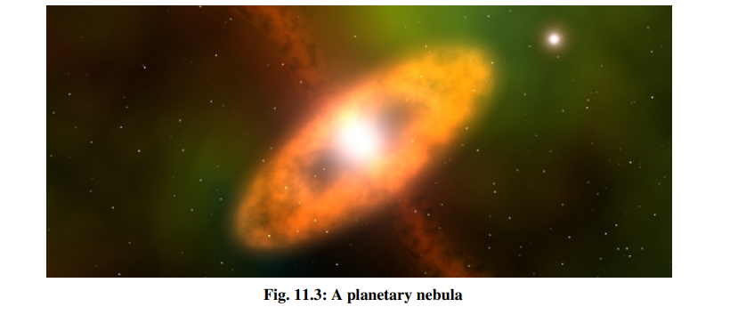
THEORY OF WHITE DWARF
After a star has exhausted its nuclear fuel, it begins to collapse due to gravity. If the mass of the star is less than about 8 MΘ, the gravitational contraction is accompanied by expulsion of matter from its outer envelope. The discarded matter forms a ring-like structure around the collapsing star and is called planetary nebula

Slide 8
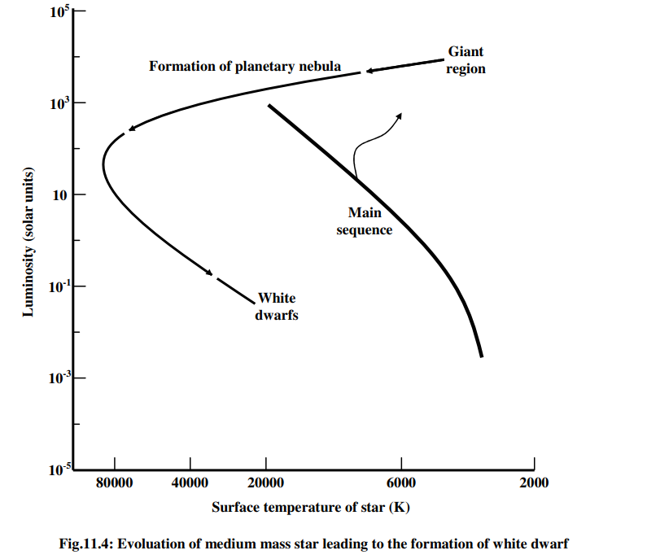
The core of the star continues to contract till its density attains a value in the range Compact Stars 10^5 − 10^8 g cm ^−3 . At this density, a new equilibrium sets in and these stars are called white dwarfs. The evolution of a medium mass star into a white dwarf is shown schematically in Fig
One of the interesting features of white dwarfs is that they have mass almost equal to the mass of the Sun, but their radii are only about five to ten thousand kilometres.

Slide 9



Chandrasekhar Limit
For a star in hydrostatic equilibrium, the pressure gradient can be expressed as:
Rho = M/R ^3
R^3 /M dp/dr = M/R^2
dp/dr = M^2 /R^5
P = M^2 R^-4
integrating from the centre to the surface, we get:

Slide 10
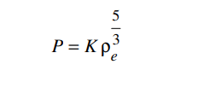



the equation of state of a degenerate gas of electrons at high density:
Eq. shows that, as the mass of the white dwarf increases, its radius decreases. The shrinking of radius is understandable because increase in mass would mean increase in the force of gravitational contraction

Slide 11
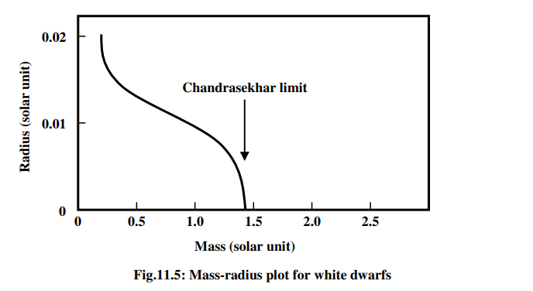
S. Chandrasekhar was awarded Nobel Prize in 1983 for his extensive theoretical work on white dwarfs.
What will happen if we go on adding mass to a white dwarf? Eq. indicates that if enough mass is added to a white dwarf, its radius would ultimately shrink to zero! What is the value of this mass? Chandrasekhar showed that if mass of the white dwarf is about 1.4 times the solar mass, its radius will shrink to zero. This is called the Chandrasekhar limit.
If the mass of the white dwarf is more than this limiting mass, its gravitational contraction cannot be balanced by the degeneracy pressure of the electrons. Thus, a star of mass greater than 1.4 solar mass cannot become a stable white dwarf unless it ejects mass in some way. No white dwarf has been discovered which has a mass higher than Chandrasekhar limit.

Slide 12
In the absence of energy generating nuclear reactions, there is actually no source of energy left in a white dwarf. Therefore, these stars would go on shining by radiating their thermal energy and in the process, their temperature would decrease. Ultimately, the entire thermal energy will be lost. The star becomes a cold object.
Suppose the luminosity of a white dwarf star of mass 1MΘ is 10^−3 LΘ. If the luminosity of the Sun, LΘ is 4 × 10^26 Js^−1 , calculate the time for which the white dwarf will keep shining with its present luminosity. (the thermal energy of a star of mass 1M Θ is 10^48 erg.)
1 erg = 10^-7 J
Luminosity of the given white dwarf star = 10^- 3 L_o
= 10^-3 x 4 x 10^26
= 4 x 10^23 J/s
Thermal energy of 1 M_o star = 10 ^48 x 10^-7 J
= 10^41 J
So time = 10^41 / (4x 10 ^23) =2.5 x 10 ^17 s = 7.93 x 10^9 years = 8 billion years
1 year = 3.154 x 10^7 seconds

